Slide 1
Lecture No. 15
Combinational Functional Devices

Slide 2
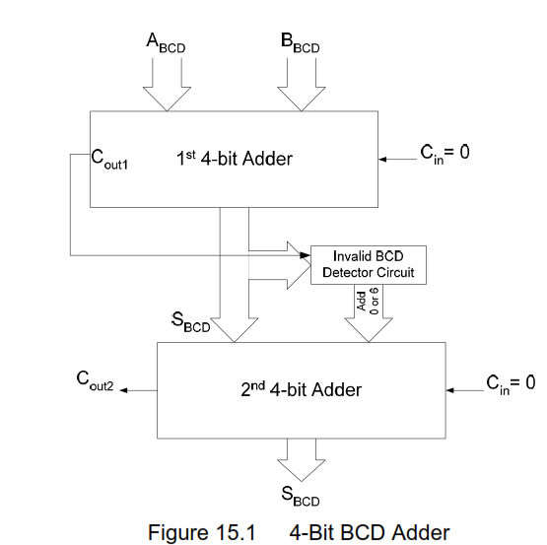
BCD Adder
Notes:
8 minutes
Total 13 minutes

Slide 3
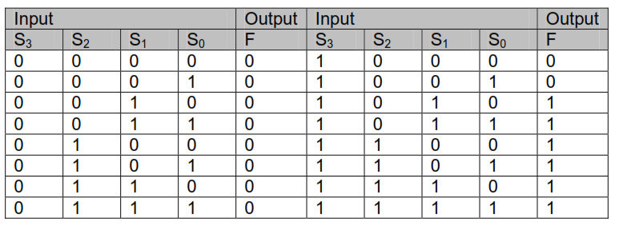
BCD Adder
Function table of invalid BCD Number Detector

Slide 4
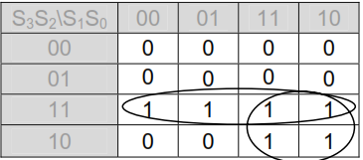
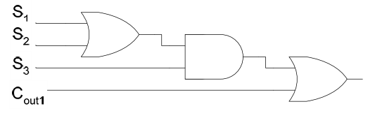
BCD Adder
Mapping Invalid BCD Number detector function
Invalid BCD Detector Circuit
Notes:
8 minutes
Total 13 minutes

Slide 5
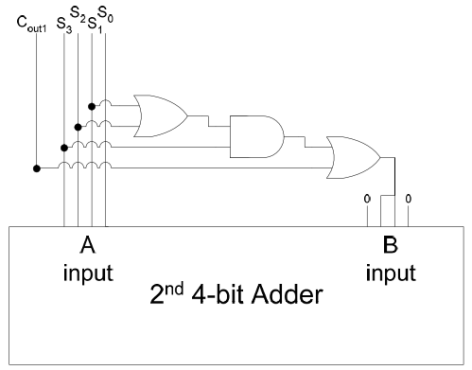
BCD Adder
Using second Adder to Add 6 or 0
Notes:
8 minutes
Total 13 minutes

Slide 6
BCD Adder
Notes:
8 minutes
Total 13 minutes

Slide 7
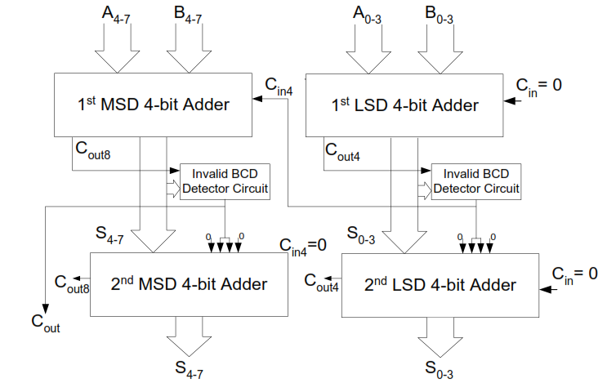
BCD Adder
2-digit BCD Adder
Notes:
8 minutes
Total 13 minutes

Slide 8
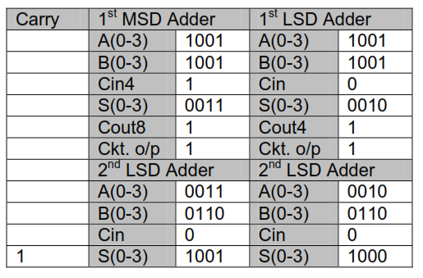
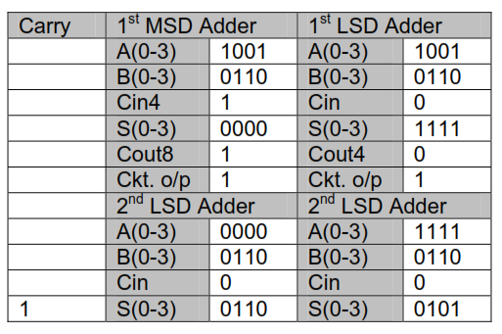
BCD Adder(Adding BCD Numbers)
Adding BCD Number
99 and 99
Adding BCD Number
99 and 66
Notes:
8 minutes
Total 13 minutes

Slide 9
Subtraction
2’s Complement Subtraction
2’s complement Subtraction example
9 1001 Invert all bits 0101
-5 1011 1010
4 1 0100 +1
1011
2’s complement of 5
Notes:
12 minute
Total 29 minutes

Slide 10
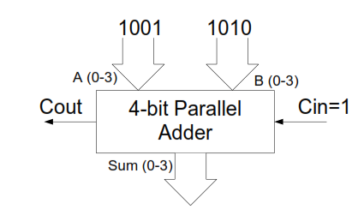
Subtraction
Subtracter Circuit
Notes:
12 minute
Total 29 minutes

Slide 11
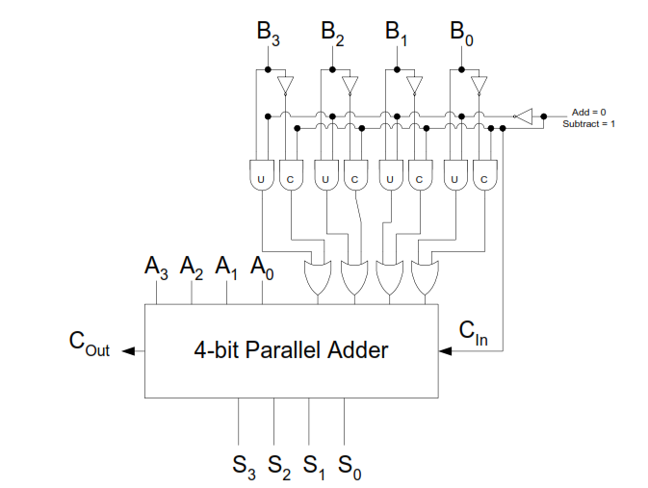
4bit Adder/Subtracter
4-bit Adder/Subtracter Unit
Notes:
12 minute
Total 29 minutes

Slide 12
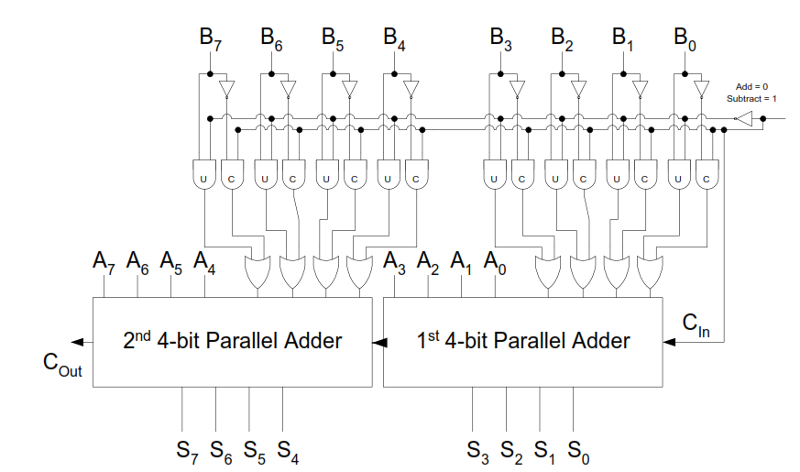
Cascading Subtraction
Notes:
12 minute
Total 29 minutes

Slide 13
4bit Adder/Subtracter
Desirable to use same hardware for both Operations
  2’s complement addition for subtraction
Overflow
  Addition/subtraction of 2 n bit numbers may produce n+1 bit output
  Problem if fixed # of bits (n) are allocated for input and output
  Must detect its occurrence
Notes:
12 minute
Total 29 minutes

Slide 14
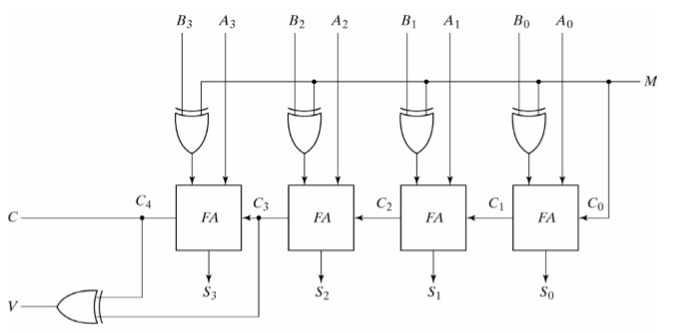
4bit Adder/Subtracter
Notes:
12 minute
Total 29 minutes

Slide 15
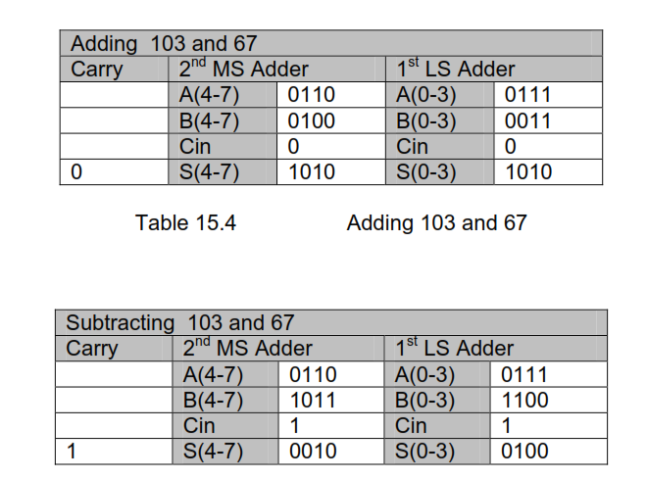
Subtraction
Addition/Subtraction examples
Notes:
12 minute
Total 29 minutes

Slide 16
ALU
MSI 4-bit ALUs
  74X181 32 functions
  74X381 8 functions group carry
  74X382 8 functions
Notes:
8 minutes
Total 37 minutes

Slide 17
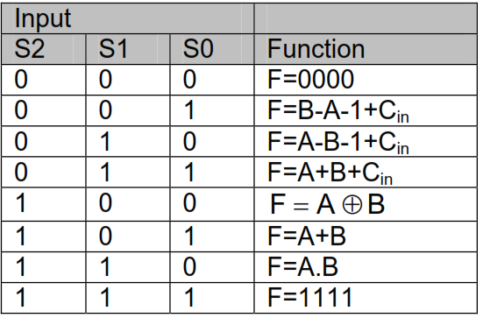
ALU
Function of 74X381 ALU
Notes:
8 minutes
Total 37 minutes

Slide 18
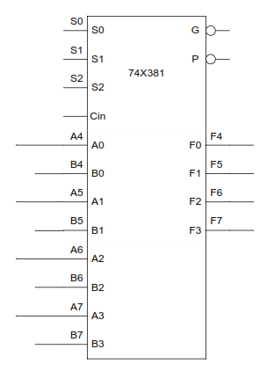
ALU
Group-Carry Look-Ahead
Notes:
8 minutes
Total 37 minutes

Slide 19
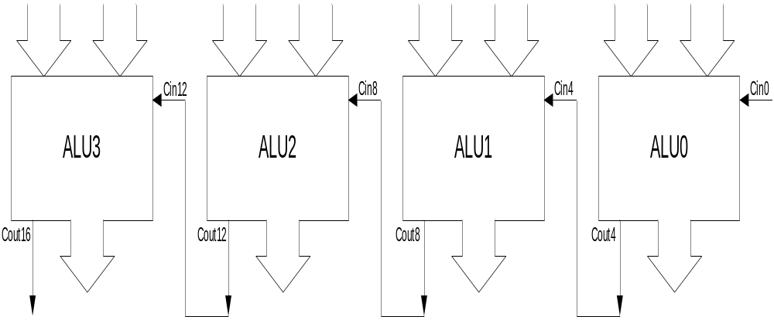
Carry Propagation Delay between 4-bit ALU units

Slide 20
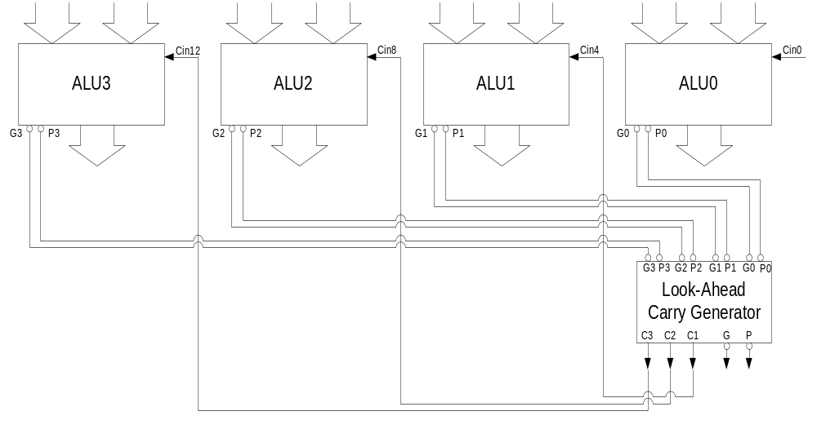
Carry Propagation Delay eliminated by using Group Carry

Slide 21
16-bit ALU
G0
G
6
P0
74X182
P
G1
P1
C4
G2
C1
C8
P2
C2
C12
G3
C3
P3
C0
C0
S(0-2)
A(0-15)
B(0-15)
S0
S0
G
S0
S0
G
S1
S1
74X381
P
P0
S1
S1
74X381
P
P2
S2
S2
S2
S2
A0
Cin
F0
A8
Cin
F8
B0
A0
F0
F1
B8
A0
F0
F9
A1
B0
F1
F2
A9
B0
F1
F10
B1
A1
F2
F3
B9
A1
F2
F11
A2
B1
F3
A10
B1
F3
B2
A2
B10
A2
A3
B2
ALU0
A11
B2
ALU2
B3
A3
B11
A3
B3
B3
S0
S0
G
S0
S0
G
S1
S1
74X381
P
P1
S1
S1
74X381
P
P3
S2
S2
S2
S2
A4
Cin
F4
A12
Cin
F12
B4
A0
F0
F5
B12
A0
F0
F13
A5
B0
F1
F6
A13
B0
F1
F14
B5
A1
F2
F7
B13
A1
F2
F15
A6
B1
F3
A14
B1
F3
B6
A2
B14
A2
A7
B2
ALU1
A15
B2
ALU3
B7
A3
B15
A3
B3
B3
F(0-15)

